Slide 1

Predicting Breast Cancer Using
Multiple Clusterings Through DNA
Medimi Gagana Sree(1SJ23AD028)
K Chandra Priya(1SJ23AD021)
S Bhavya Sree(1SJ23AD051)
Pallavi B Gowda(1SJ23AD035)
Under the guidance of
Mr. Badrinath K
Assistant Professor, Dept of AI&DS,SJCIT

Slide 2
ABSTRACT
Breast cancer is a common disease, and early prediction can help in better treatment. Our project predicts breast cancer risk by analyzing DNA and SNP genetic data. Multiple clustering techniques are used to group individuals based on genetic similarities. The clusters are analyzed to identify genetic patterns associated with breast cancer.This system aims to support early risk assessment and better understanding of genetic factors.

Slide 3
INTRODUCTION
Breast cancer is one of the most common cancers affecting women worldwide.Early detection and risk prediction can help in providing timely treatment. DNA contains genetic information that can reveal variations related to diseases.SNPs (Single Nucleotide Polymorphisms) are small genetic variations that can be studied for this purpose. Our project analyzes SNP-based DNA data to identify patterns associated with breast cancer. Multiple clustering techniques are used to group individuals based on genetic similarities. The project aims to identify high-risk genetic patterns and support early breast cancer risk prediction.

Slide 4
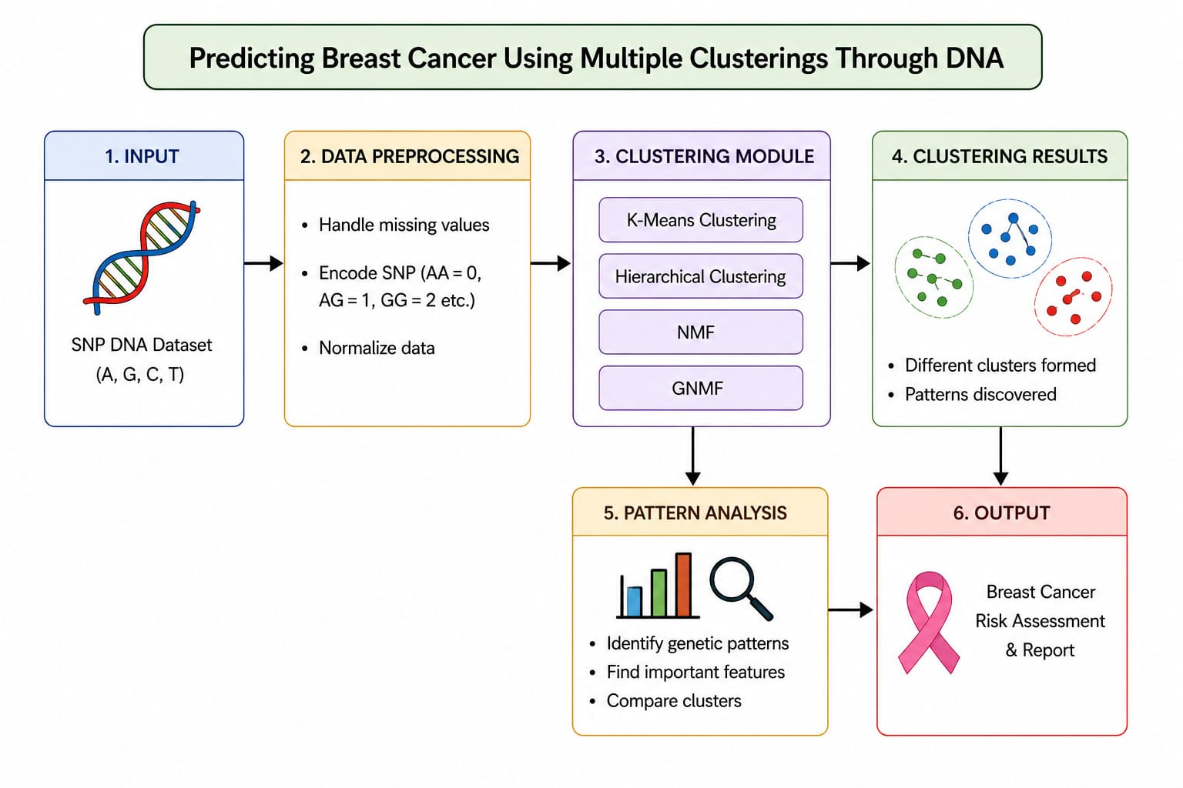
DESIGN

Slide 5
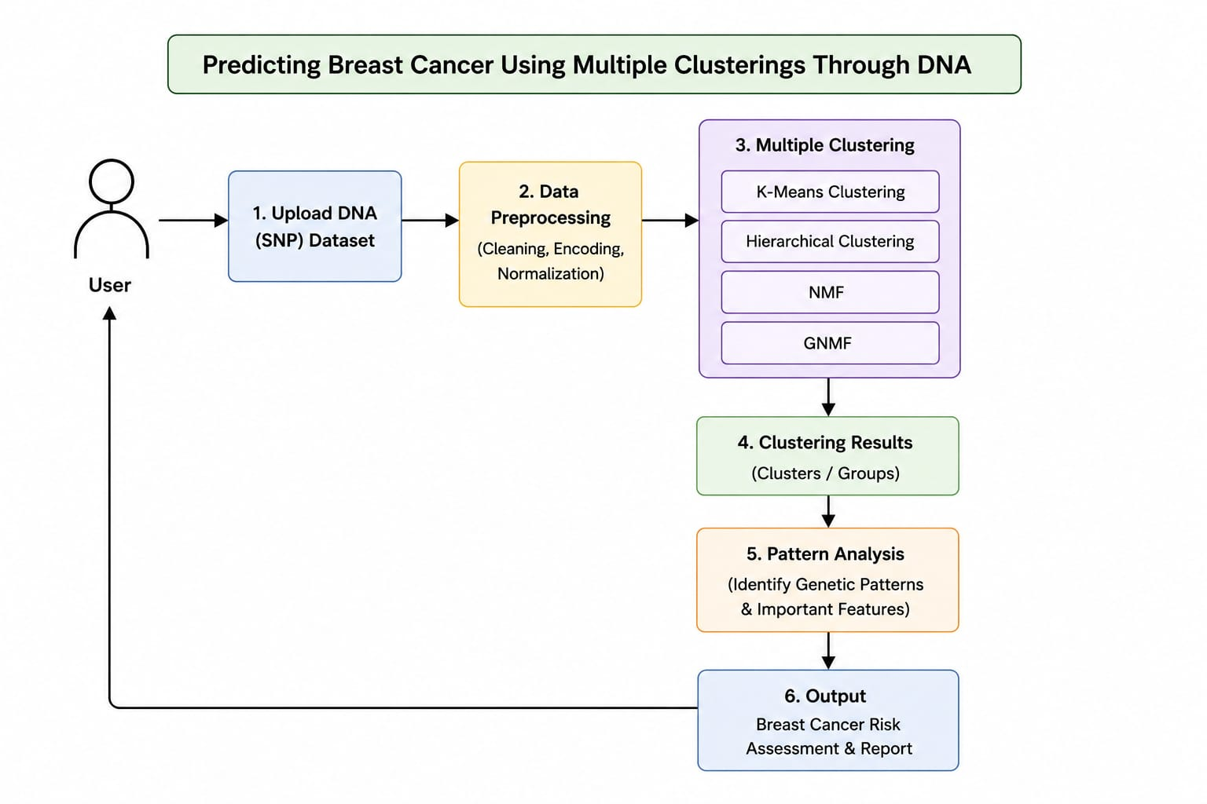
DATA FLOW DIAGRAM

Slide 6
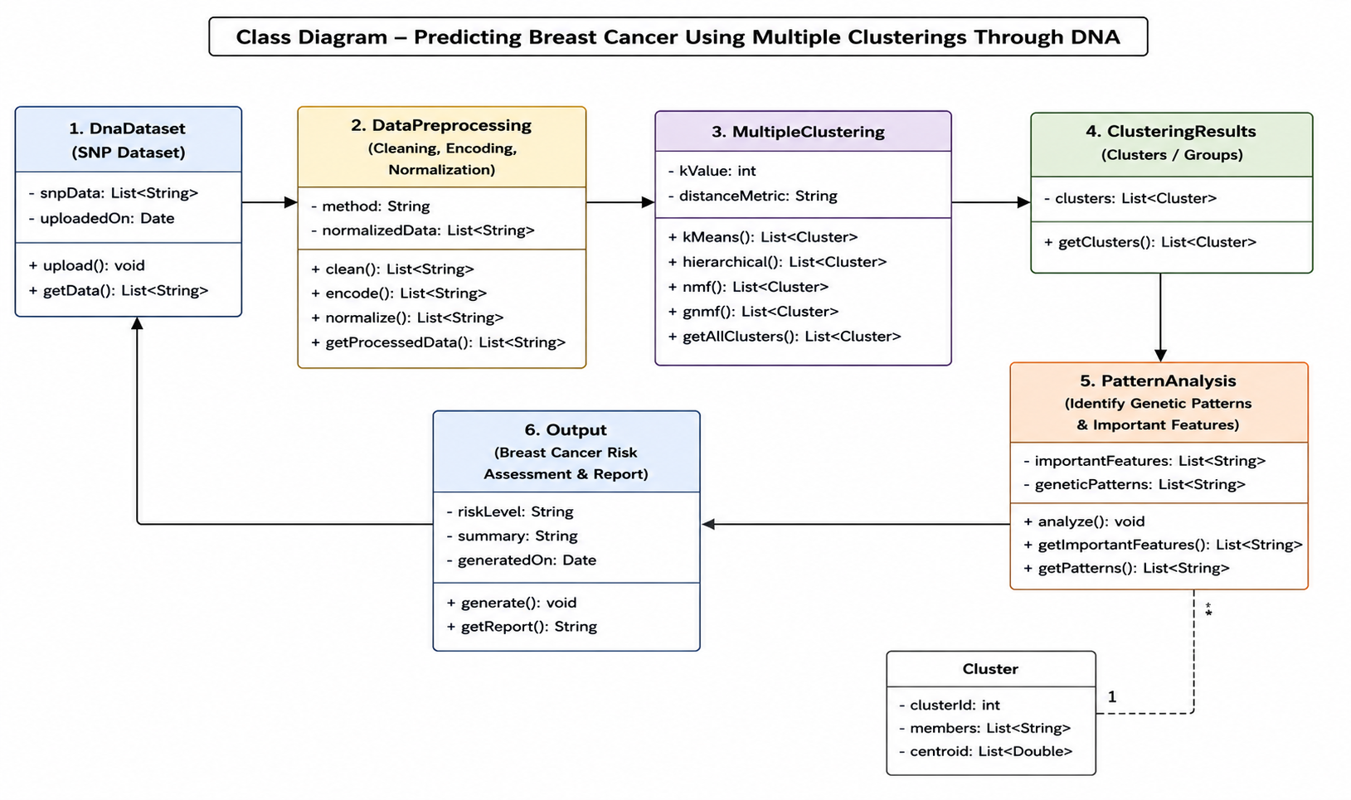
CLASS DIAGRAM

Slide 7
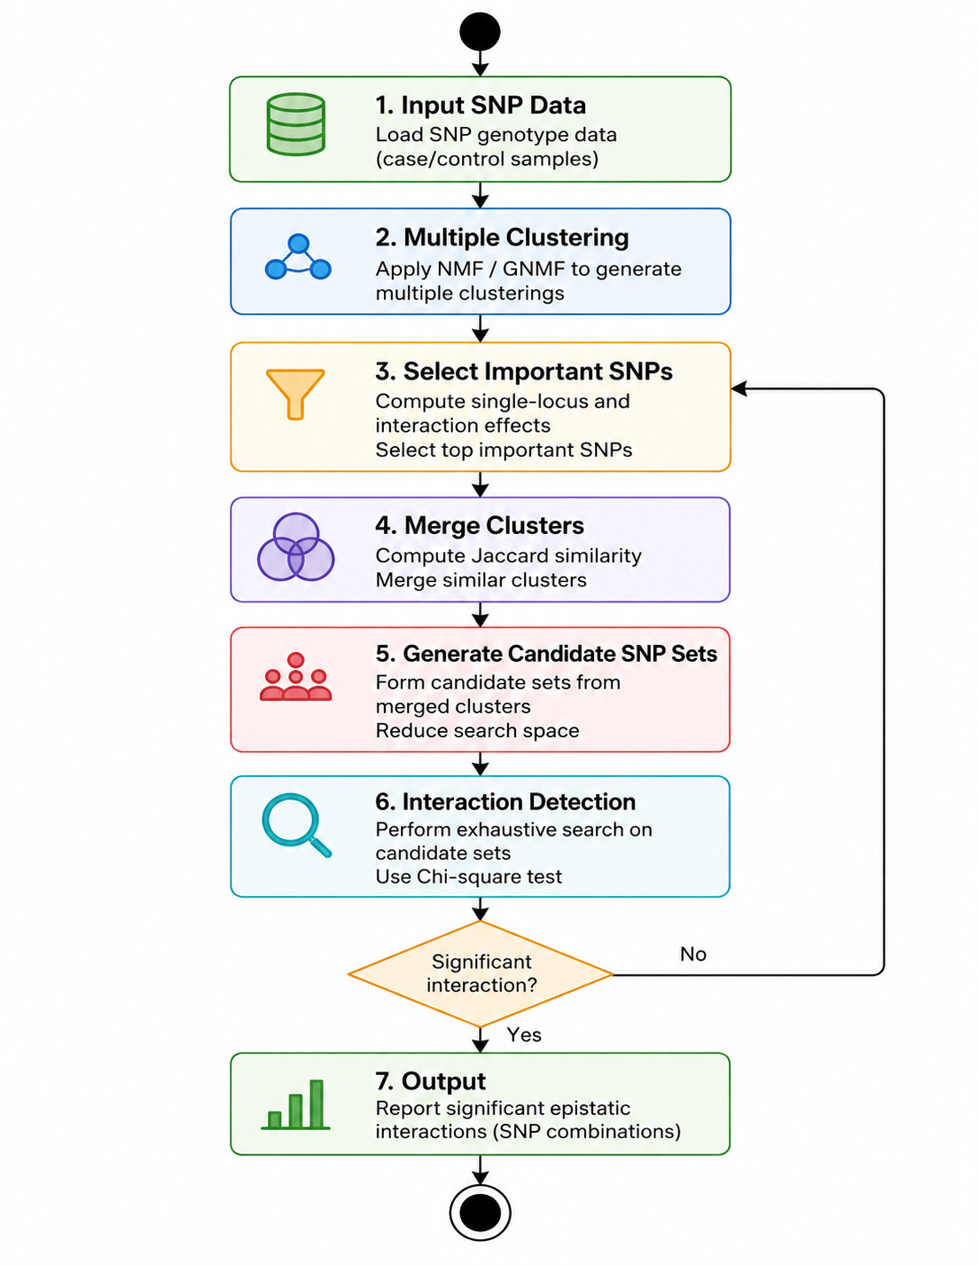
ACTIVITY DIAGRAM

Slide 8
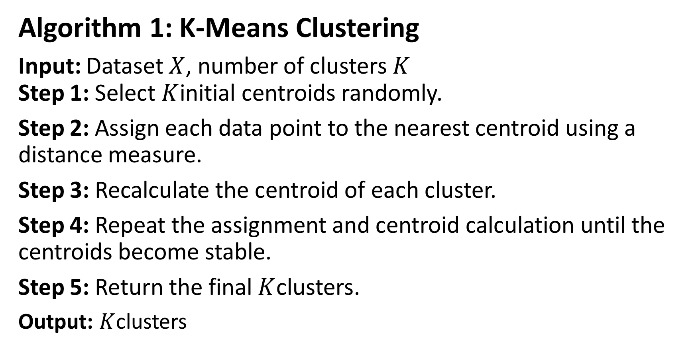
IMPLEMENTATION
Algorithm 1: K-Means Clustering
Input: Dataset $X$, number of clusters $K$
Step 1: Select $K$initial centroids randomly.
Step 2: Assign each data point to the nearest centroid using a distance measure.
Step 3: Recalculate the centroid of each cluster.
Step 4: Repeat the assignment and centroid calculation until the centroids become stable.
Step 5: Return the final $K$clusters.
Output: $K$clusters

Slide 9
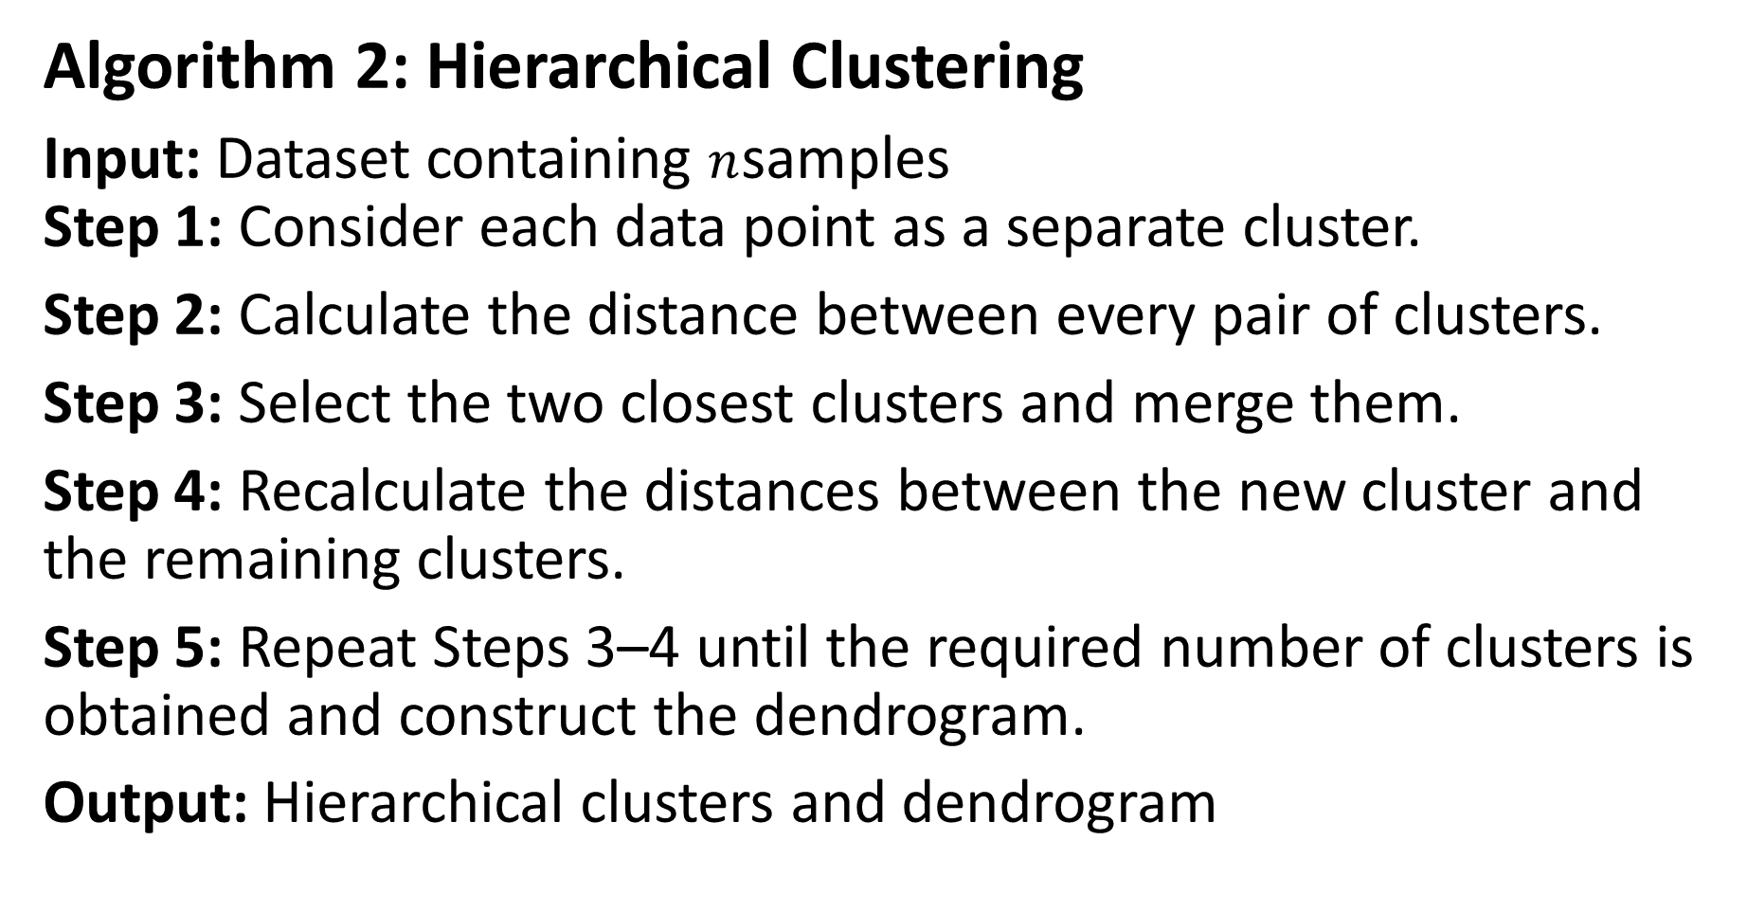
Algorithm 2: Hierarchical Clustering
Input: Dataset containing $n$samples
Step 1: Consider each data point as a separate cluster.
Step 2: Calculate the distance between every pair of clusters.
Step 3: Select the two closest clusters and merge them.
Step 4: Recalculate the distances between the new cluster and the remaining clusters.
Step 5: Repeat Steps 3–4 until the required number of clusters is obtained and construct the dendrogram.
Output: Hierarchical clusters and dendrogram

Slide 10
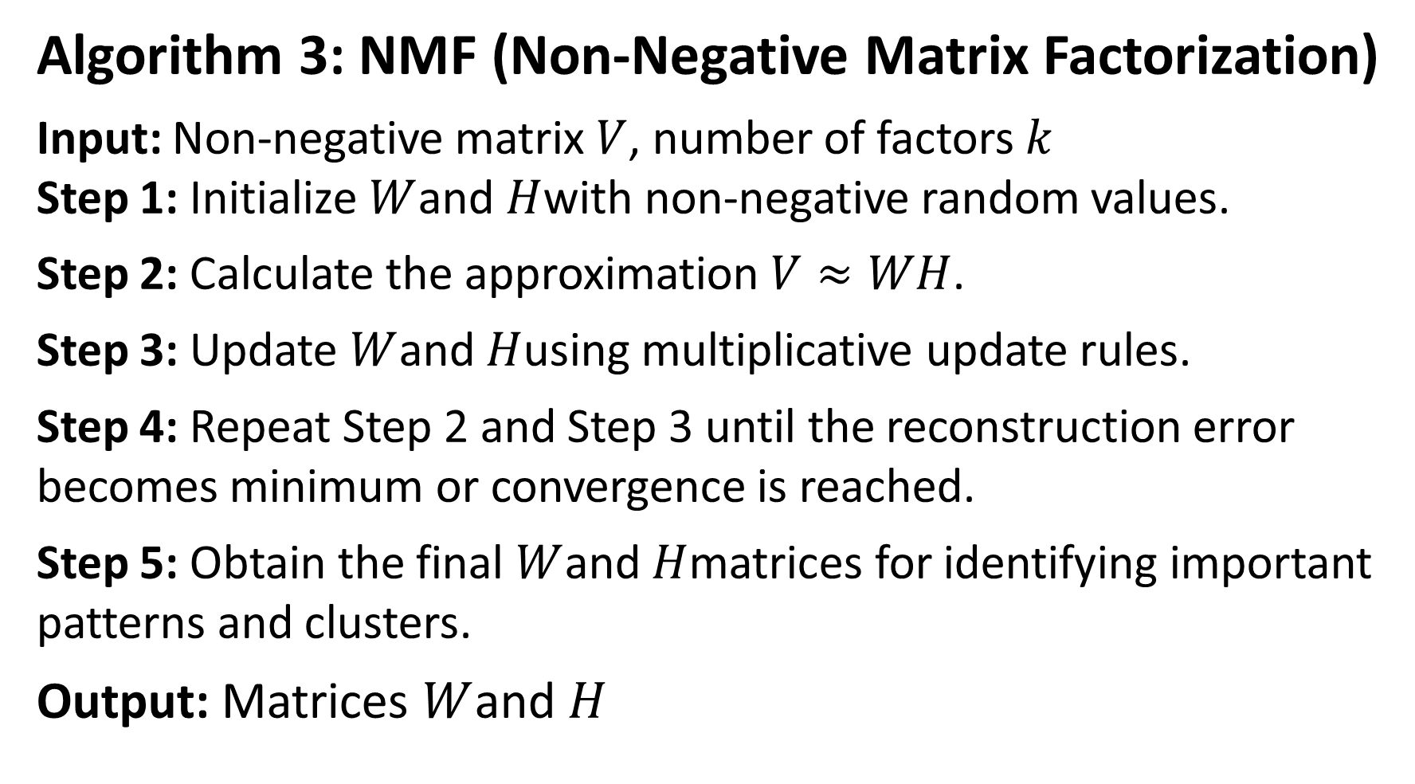
Algorithm 3: NMF (Non-Negative Matrix Factorization)
Input: Non-negative matrix $V$, number of factors $k$
Step 1: Initialize $W$and $H$with non-negative random values.
Step 2: Calculate the approximation $V≈WH$.
Step 3: Update $W$and $H$using multiplicative update rules.
Step 4: Repeat Step 2 and Step 3 until the reconstruction error becomes minimum or convergence is reached.
Step 5: Obtain the final $W$and $H$matrices for identifying important patterns and clusters.
Output: Matrices $W$and $H$

Slide 11
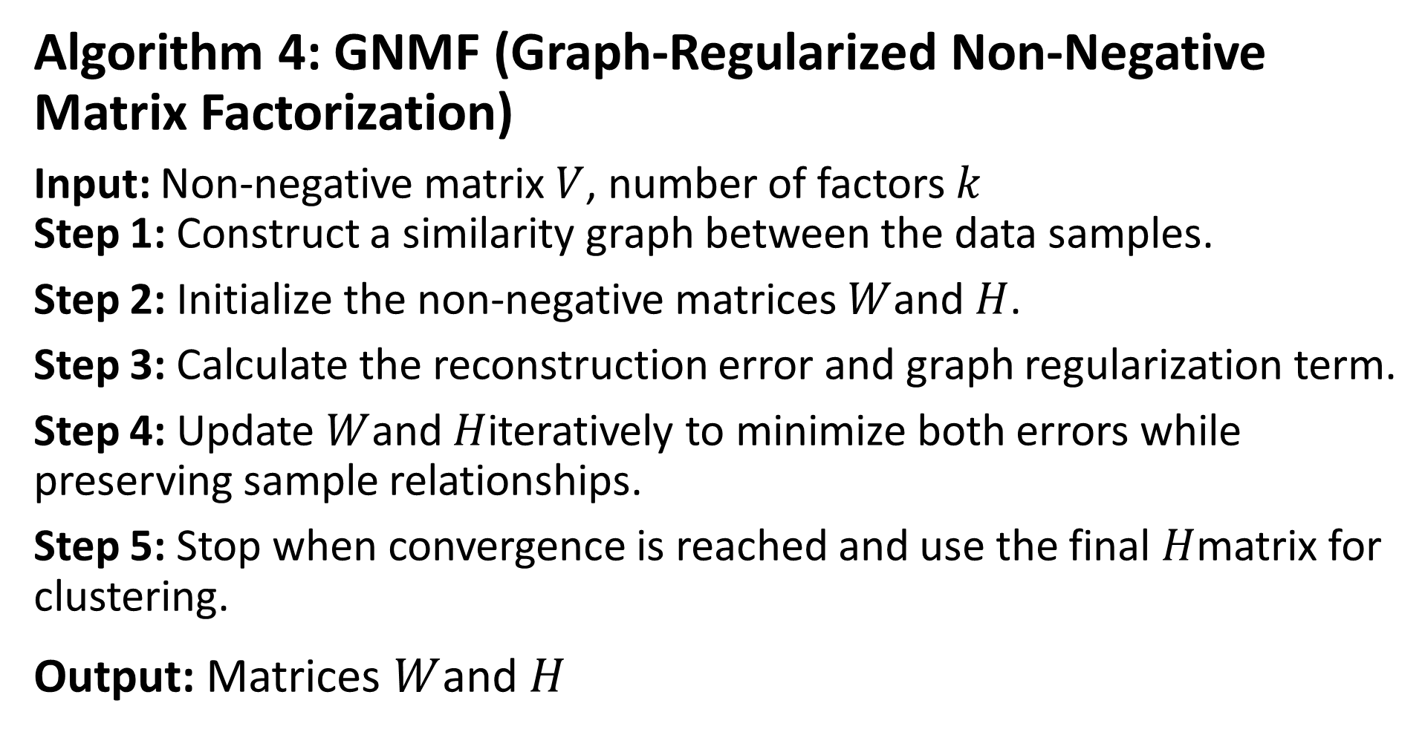
Algorithm 4: GNMF (Graph-Regularized Non-Negative Matrix Factorization)
Input: Non-negative matrix $V$, number of factors $k$
Step 1: Construct a similarity graph between the data samples.
Step 2: Initialize the non-negative matrices $W$and $H$.
Step 3: Calculate the reconstruction error and graph regularization term.
Step 4: Update $W$and $H$iteratively to minimize both errors while preserving sample relationships.
Step 5: Stop when convergence is reached and use the final $H$matrix for clustering.
Output: Matrices $W$and $H$

Slide 12
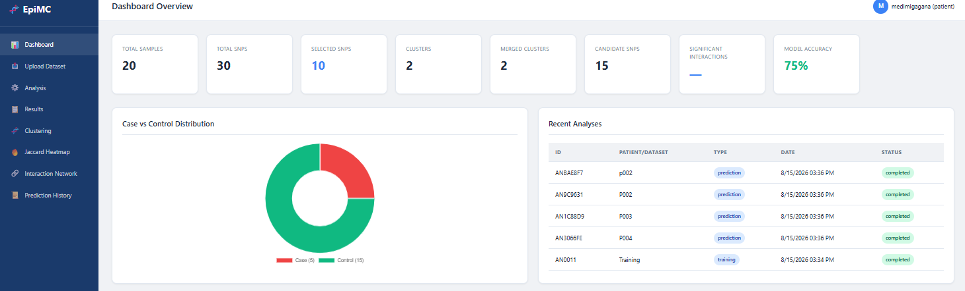
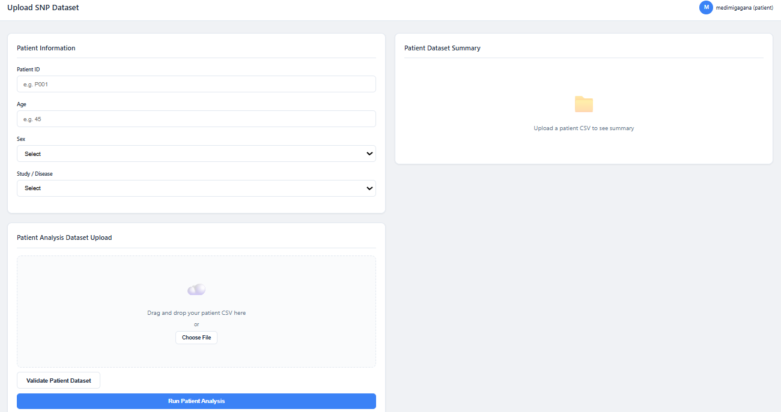
SNAP SHOTS
Fig1:Dashboard
Fig2: Upload SNP Data Set

Slide 13
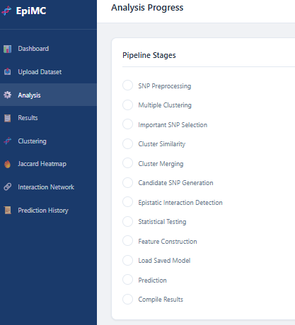
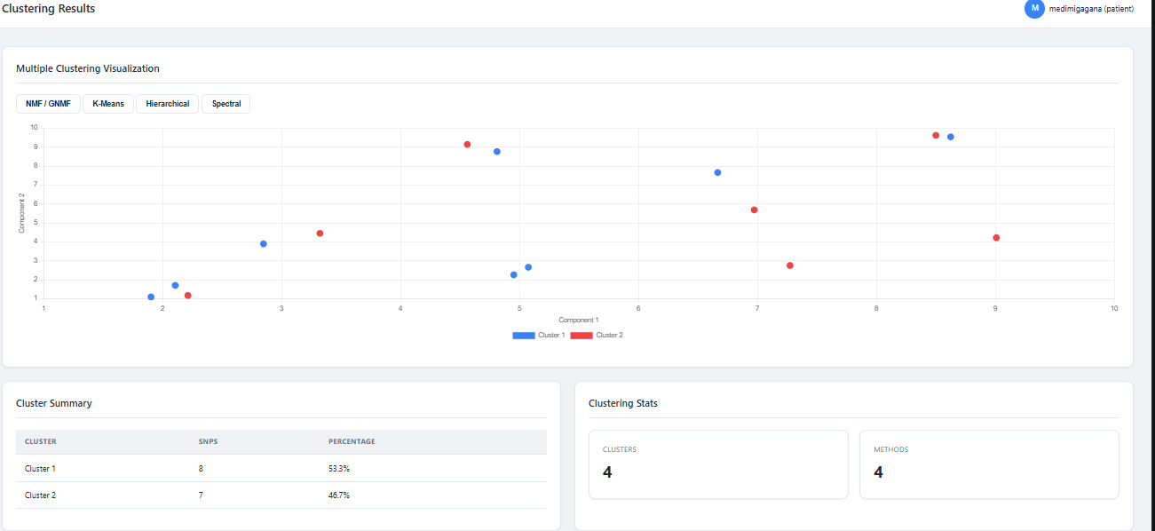
Fig4: Clustering Results
Fig3: Analysis Progress

Slide 14
CONCLUSION
The project “Predicting Breast Cancer Using Multiple Clustering Techniques Through DNA Data” aims to identify meaningful patterns in genetic data related to breast cancer. NMF, GNMF, Hierarchical Clustering, and K-Means are used to analyze and group similar DNA patterns. These techniques help in discovering hidden relationships and important features in the dataset. The proposed approach can support better understanding of genetic variations associated with breast cancer. Overall, the project demonstrates how machine learning and DNA analysis can be combined for breast cancer research and prediction.

Slide 15
REFERENCES
N. Cristianini and M. W. Hahn, Introduction to Computational Genomics: A Case Study in Cancer Research, Cambridge University Press, 2006.
D. M. W. H. G. et al., “The Cancer Genome Atlas: A Comprehensive Multidimensional Map of the Genomic Landscape of Breast Cancer,” Nature, vol. 490, pp. 61–70, 2012.
J. P. Brunet et al., “Metagenes and Molecular Pattern Discovery Using Matrix Factorization,” Proceedings of the National Academy of Sciences (PNAS), vol. 101, no. 12, pp. 4164–4169, 2004.

Slide 16
THANK YOU

